Slide 1
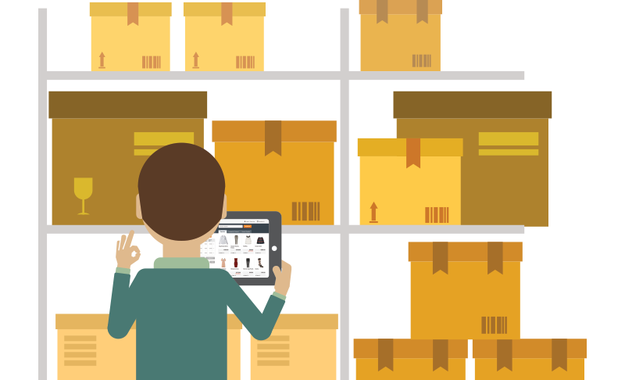
Inventory Management
Par Level
Provided by the LAUSD Food Services Division
Notes:
Tell: Hello and welcome to the Inventory Management training.

Slide 2
Overview
This training will cover inventory par levels and the effect it has on a cafeteria operation including:
Ordering
Organized receiving habits
Effective daily forecasting
Notes:
Tell: Throughout this training we will understand why par level is important to your cafeteria operation and how it will affect operational cost. This includes ordering, the benefits of organized receiving habits, the positive results of effective daily forecasting will aid in improving the inventory levels.
Next Slide

Slide 3
Purpose and Benefits
By understanding the role of inventory and its sub-components, FSM’s will improve the operational efficiency of their cafeteria.
This will help lower the operating cost of the cafeteria by:
Increasing inventory turn-over rate
Reducing on-hand inventory levels
Reducing theft, waste, and loss of product
Notes:
Tell: By understanding the role of inventory and its sub-components in controlling the operational cost, FSM’s will improve the operational efficiency of their cafeteria. This will help lower the operating cost of the cafeteria by increasing inventory turn-over rate. Knowing on-hand inventory levels, it will also reduce theft, waste, and loss of product.
Next Slide

Slide 4
Objective
Food Service Managers will improve their cafeteria operation by implementing effective inventory management practices that will:
Improve ordering
Reduce cost of inventory
Control inventory levels
Notes:
Tell: As a result of this training, Food Service Managers will improve their cafeteria operation by implementing effective inventory management practices that will improve cafeteria ordering, reduce the over-production of menu items, and control inventory levels.
Next Slide

Slide 5
The Inventory Cycle
The goal of good inventory management is to limit the inventory tying up operating funds. The best way to ensure proper inventory levels is by constantly counting the items used, and order according to the usage per day.
*Definition of Inventory Cycle: A method of keeping track of inventory by performing inventory counts constantly on a frequent and regular basis.
* Business Dictionary
Notes:
Tell: The goal of good inventory management is to limit the inventory tying up operating funds. The best way to ensure proper inventory levels is by constantly count the items used, and order accordingly to the usage per day.
Once you know this information, it is very easy to calculate the number of items needed to operate per day.
Remember, there may be an outlier in your schedule, such as Holidays, vandalism, or damaged products due to flooding, fire or sewage spill. In this case you will need to reassess your products and order accordingly to keep your par level.
Next Slide

Slide 6
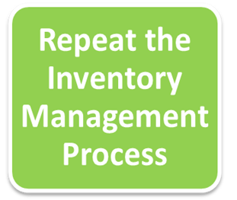
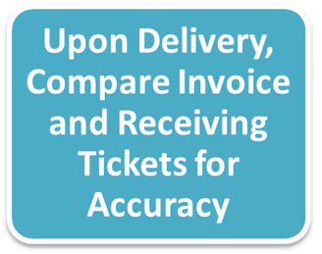
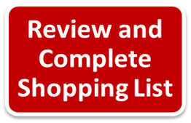
Inventory Management Process
Start
Notes:
Tell: The inventory process depends on the type of item being controlled. Food items will rely on proper daily forecasting and making adjustments to the generated shopping list if necessary. (animation 1)For non-food items, establish efficient par levels and add those items manually to the shopping list. (animation 2) Both food and non-food items must be reviewed on their shopping list before completing the order within CMS. (animation 3) Upon delivery, compare invoice and receiving tickets for accuracy. (animation 4) Repeat this inventory management process on a regular basis to ensure that you meet the needs of your customers while reducing cost.
Next Slide

Slide 7
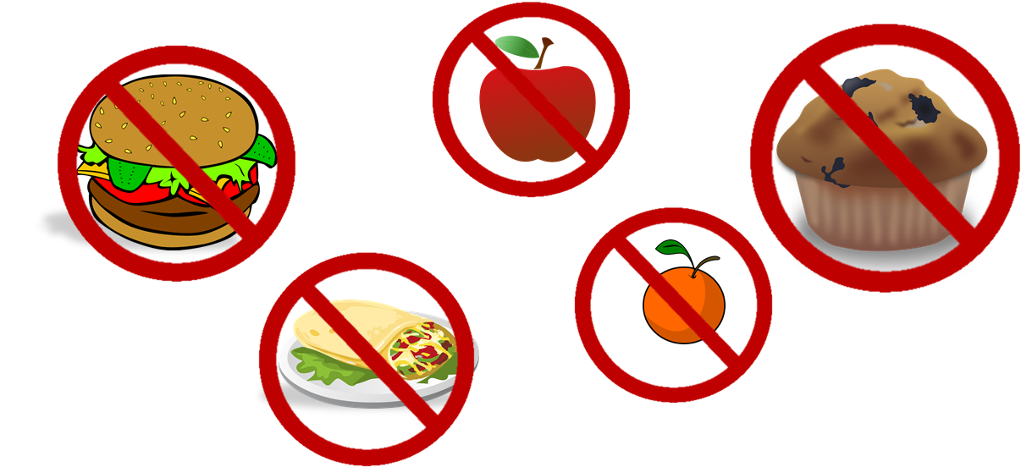
Par Level
Par levels are the normalized usage amount of an item that is generally used. They set a maximum stock level that standardizes the ordering process.
Order paper and chemicals based on a history of use.
Food should not be used as Par stock items.
Notes:
Tell: Par levels are based on the normal usage amounts of items that are continuously used. They set a maximum stock level that help to standardize the ordering process. This inventory control tactic is effective for ordering paper and chemicals as it is based on usage history. As such, be sure to use an accurate daily average use figure to calculate a par level. (animation 1) Do not keep a par level for food. Since our menu rotates throughout the month, a par level of food items would add unnecessary cost to your cafeteria cost. Order food according to the menu and forecasting. (animation 2)A par level should, however, be used for paper goods and chemical supplies are used in a predictable manner.

Slide 8
Par Level Calculation
Order paper and chemical supplies based on the history of use. Set-up a Par level and order according to these levels.
To calculate Par level:
Calculate orders to cover the days between deliveries, plus an additional day of inventory as a safety stock.
Evaluate the par level on a monthly basis to meet the needs of cafeteria.
Average Daily Use X # of operating days | Safety Stock (1 Day Cushion) | Par Level
Notes:
Tell: FSM’s should order paper and chemical supplies based on the history of use. FSM’s should set-up a par level for each item and order per these levels. The Par level of chemical and paper supplies should only be enough to cover the time between delivery date, plus an additional one day inventory as safety stock (cushion). To establish the par Levels, FSM’s should document the Daily Usage of an item and then multiply that by the number of days between delivery. Remember, orders placed on Thursday of week one will not be delivered until the delivery date of week three. Keep in mind, you will have a delivery already in place for week 2. As a precaution, FSM’s should add a minimal cushion to accommodate any spikes in participation or delivery not arriving on time. The minimum in stock always should be the 1 day cushion. The maximum inventory should not exceed the par level. Monitor these maximum values daily. FSM’s should evaluate the par level monthly to ensure that these levels meet the needs of the cafeteria.
Next Slide

Slide 9
Par Level Calculation Example
A cafeteria uses 1.5 cases of Carry-out trays per day. The cafeteria receives its delivery on Tuesday (5 operational days between delivery). We want to have 1.5 case as safety stock. What is the par level?
1
Average Daily Use X # of operating days | 1 day Usage | Par Level
2
(1.5 X 5) | 1.5 | ?
3
7.5 | 1.5 | 9
Notes:
Tell: Let’s calculate the par level of carry-out trays for this cafeteria. If the cafeteria uses 1.5 cases per day, and receives a delivery every Tuesday, we will multiply that daily use by the number of operating days for a total of 7.5 cases. Now, all we need to do is add a single days stock to the 7.5 cases to establish a par level which will be 9 cases. In this case, the minimum stock should be 1.5 cases and the maximum would be 9 cases. Monitor these levels daily. If there is only a single day in stock the day before your delivery day, you should recalculate your par level.
Next Slide

Slide 10
Test Your Knowledge: Par Level
Cloverleaf Elementary cafeteria uses .75 cases of sporkettes per day. They receive their delivery every Tuesday. What is the par level?
1
Average Daily Use X # of operating days | 1 day Usage | Par Level
2
.75 X 5 | .75 | ?
4.5
Notes:
Tell: Let’s test our knowledge. Cloverleaf Elementary uses .75 cases of sprokettes. What is their Par level? First we need to determine how many operating days between delivery, which is 5. (click to animate) Don’t forget to add one day usage for cushion. The new Par Level is now????? 4.5. (click to animate)
Next Slide

Slide 11
Ordering Using Par Level
Using the par level for ordering will help to maintain a low level of non-moving inventory while providing a safety stock for unexpected events.
To calculate orders using your par level:
You have 2.5 cs of carry-out trays on hand
Par level 9
Minus on hand 2.5
Equals Order 6.5 or 7 cs.
Notes:
Tell: Using the par level for ordering will help to maintain a low level of non-moving inventory while providing a cushion for unexpected events. On every Thursday, all schools should complete editing and save the shopping list for Grocery and Staples. Calculate the amount of items on hand on delivery date. Use the par level and minus the amount on hand to determine orders. . For this example, let’s use our par level of 9 carry-out tray cases from the previous slide, then subtract the remaining amount to place order.
Next Slide

Slide 12
Forecasting For Holidays and UA Days
Keep in mind, during the school year, there will be Holidays and Unassigned days. It is not necessary to order food and supplies for those non-working days.
Here are some examples of the Holidays we observe:
Veterans Day
Thanksgiving
Presidents’ Day
Memorial Day
Reminder: Do not include these single holidays or any Unassigned days to your forecasting.
Notes:
TELL: Keep in mind, during the school year, there will be Holidays and Unassigned days. It is not necessary to order food and supplies for those non-working day. Here area some example of the Holidays we observe:
Veterans Day, Thanksgiving, Presidents’ Day, Memorial Day, etc…
Remember not to include these single holidays or any unassigned days to your forecasting.

Slide 13
Activity #1: Forecasting 1 Day A Week Delivery
Penguin Elementary uses 1.5 cases of sporkettes per day.
Edit and Save Shopping List must be completed by Thursday
The delivery day for Grocery and Staples is every Tuesday
Answer the following questions on the handout for Activity 1A, to forecast the orders.
Notes:
Hand out Activity 1 and 2 to participants.
TELL: Let’s start with Activity #1. Penguin Elementary uses 1.5 case of sporkettes daily.
This school receives a 1 day delivery for Grocery and Staples, which is every Tuesday
Shopping list must be edit and complete every Thursday.
Answer the following question for Activity #1 to complete the calendar for October and November.
(Allow 10 minutes to complete Activity #1)
Next Slide

Slide 14
Activity #1A: Forecasting 1-Day Delivery
October 2017
Monday | Tuesday (Delivery day) | Wednesday | Thursday (Forecast Use) | Friday
2 | 3 12 cs | 4 10.5 cs | 5 9 cs Order Amt. ____ | 6 7.5 cs
9 6 cs | 10 4.5cs Delivery 5_ Total 9.5 | 11 8 cs | 12 6.5 cs | 13 5 cs
16 3.5 cs | 17 2 cs | 18 | 18 | 19
23 | 24 | 25 | 26 | 27
30 | 31
Delivery 7 cs
9
1.5 cs Delivery 8 cs
9.5
2 cs Delivery 7 cs
9
Notes:
TELL: Let’s go over for the month of October.
Explanation: There are 5 operating days in between delivery. Wed, Thurs, Fri, Mon, and Tues. = 5
5 X (Daily Usage) 1.5 = 7.5
Add Cushion of 1.5
Equals 9
Knowing that the Par level is 9 cases, we need to maintain that amount every week on delivery day. Remember, this cafeteria uses 1.5 cases per day, which includes BIC, Lunch and Supper. By subtracting 1.5 per day usage until the next delivery, we should be able to place an order based on the information. Continue calculating the remainder of October. (Give participants 5 minutes to compete)
ASK: How many cases of sporkettes are needed for Oct. 17, 24, and 31st?
(click for Answer, group discussion if necessary)
Next Slide

Slide 15
Activity #1B: Forecasting 1-Day Delivery (Answer 2)
November 2017
Monday | Tuesday | Wednesday | Thursday | Friday
 |  | 1 7.5 | 2 | 3
6 | 7 | 8 | 9 | 10 Holiday
13 | 14 | 15 | 16 | 17
20 UA | 21 UA | 22 UA | 23 Holiday | 24 Holiday
27 | 28 | 29 | 30
1.5cs Delivery 8__
9.5
3.5 cs
Delivery 6__
9.5
2 cs
Delivery 7__
9
Notes:
TELL: Now, let’s look at November’s order. We already know on Nov. 1st, there will be 7.5 cases on hand. By doing the math, we can forecast how many cases of sporkettes is needed for the next few weeks. Remember, on Holidays and unassigned days, the school will be closed and no supplies should be ordered.
ASK: How many cases of sporkettes needed on Tuesdays for the month? (Click for answer)
Next Slide

Slide 16
Activity #2: Forecasting 2 Days A Week Delivery
Sunny Day MS uses 2.25 cs of carry-out trays per day. This school has a 2-day delivery schedule.
Edit and Save Shopping List must be completed by Thursday
Delivery days for Grocery and Staples are every Monday and Wednesday
Answer the following questions on the handout for Activity #2, to forecast the orders.
Notes:
TELL: Next we have Sunny Day MS that uses 2.25 cases of carry-out trays.
This school receives their delivery 2 days a week, which is every Mondays and Wednesdays.
Shopping list must be edit and complete every Thursday.
Answer the following questions for Activity #2 to complete the calendar for October and November.
(Allow 10 minutes to complete Activity #2)
Next Slide

Slide 17
Activity #2A: Forecasting 2 Days A Week Delivery (Answer)
October 2017
Monday (Delivery day) | Tuesday | Wednesday (Delivery day) | Thursday (Forecast Use) | Friday
2 6.75 | 3 4.5 | 4 2.25 Delivered 8 cs. 10.25 | 5 8 Order Amt. ____ Order Amt. ____ | 6 5.75
9 3.5 Delivery 6 cs. 9.5 | 10 7.25 | 11 5 Delivery 6 cs. 11.5 | 12 9.25 | 13
16 4.75 | 17 | 18 3.25 | 19 | 20
23 | 24 | 25 | 26 | 27
30 | 31 5
Delivery 3 cs
7.75
Delivery 6 cs
9 cs
2.5
Delivery 5 cs
7.5
3 cs
Delivery 6 cs
9
2.25
Delivery 5 cs
7.25
Notes:
TELL: On Thursday Oct, 5th, forecast the delivery for Monday and Wednesday. Make sure you are ordering the correct amount for those days. How many cases were ordered for November 16th and 18th? (Click to reveal answers) Did you order the right amount of carry-out trays for October 23rd, 25th, and 30th?
Let’s take a look at November’s ordering.
Next Slide

Slide 18
Activity #2B: Forecasting 2 Days A Week Delivery (Answer)
November 2017
Monday | Tuesday | Wednesday | Thursday | Friday
 |  | 1 | 2 | 3
6 | 7 | 8 | 9 | 10 Holiday
13 | 14 | 15 | 16 | 17
20 UA | 21 UA | 22 UA | 23 Holiday | 24 Holiday
27 | 28 | 29 | 30
2.75
Delivery 7_
9.75
3
Delivery 4_
7
2.5
Delivery 7_
9.5
5
Delivery 2_
7
2.5
Delivery 7_
9.5
5
Delivery 2_
7
2.5
Delivery 7_
9.5
Notes:
TELL: Continuing from October calendar, complete November’s forecast. Remember, Holidays and unassigned days will affect your forecasting. (Give participants 5 min. to compete. Click to reveal answers) Did you order correctly?
Next Slide

Slide 19
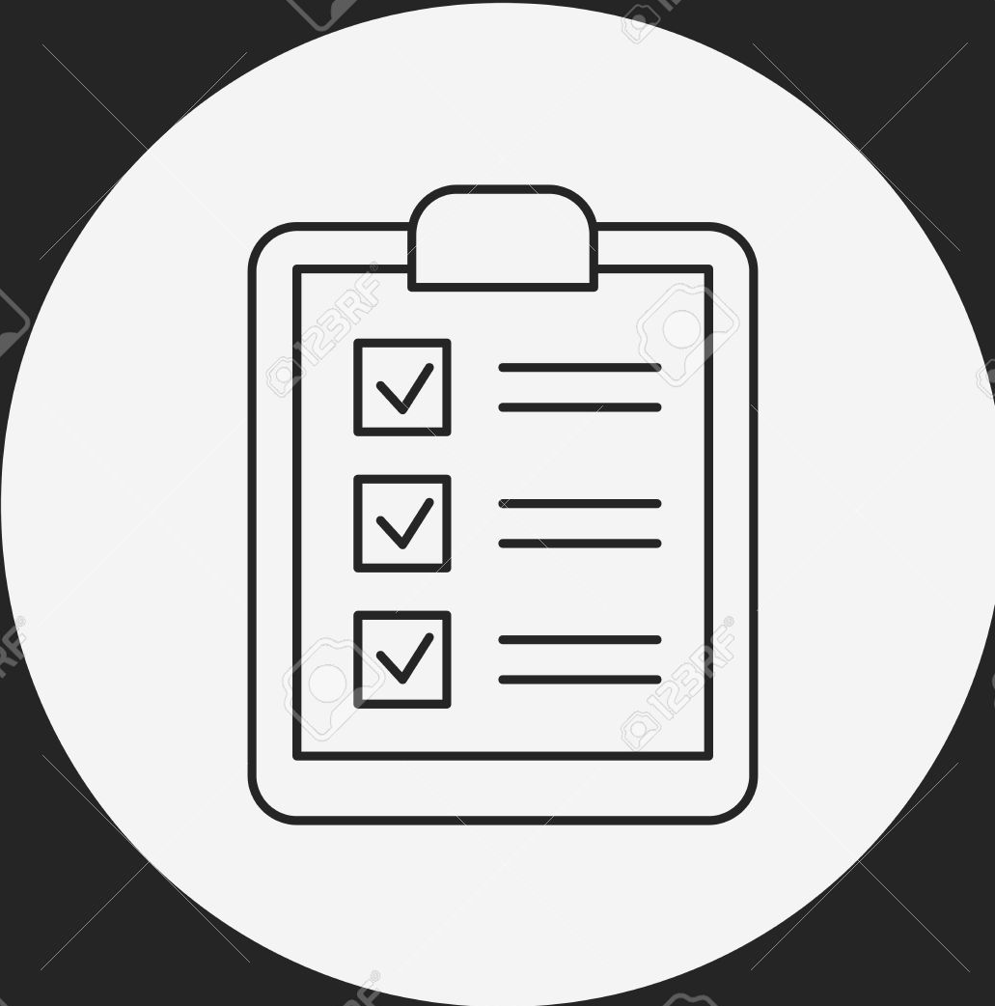
Completing The Shopping List
Prior to completing shopping list ensure that common, low usage menu items such as spices, beans, tomato paste, and croutons are removed if not needed.
Review shopping list
Remove unneeded items
Add any needed items
Edit and Save Shopping List
All shopping list should be completed according to the CMS ordering calendar by 3:00 pm.
Notes:
Tell: Prior to completing shopping list ensure that common, low usage menu items such as spices, beans, tomato paste, and croutons are removed from the shopping list unless they are needed. FSM’s should review the shopping list and remove the unneeded items from the shopping list prior to completing. FSM’s should then add any needed items that are not automatically added to the shopping list which may include adding a manual shopping list such as chemical or supplies order. Remember, all shopping list should be edited and saved by 3:00 pm, in accordance with the CMS ordering calendar.
Next Slide

Slide 20
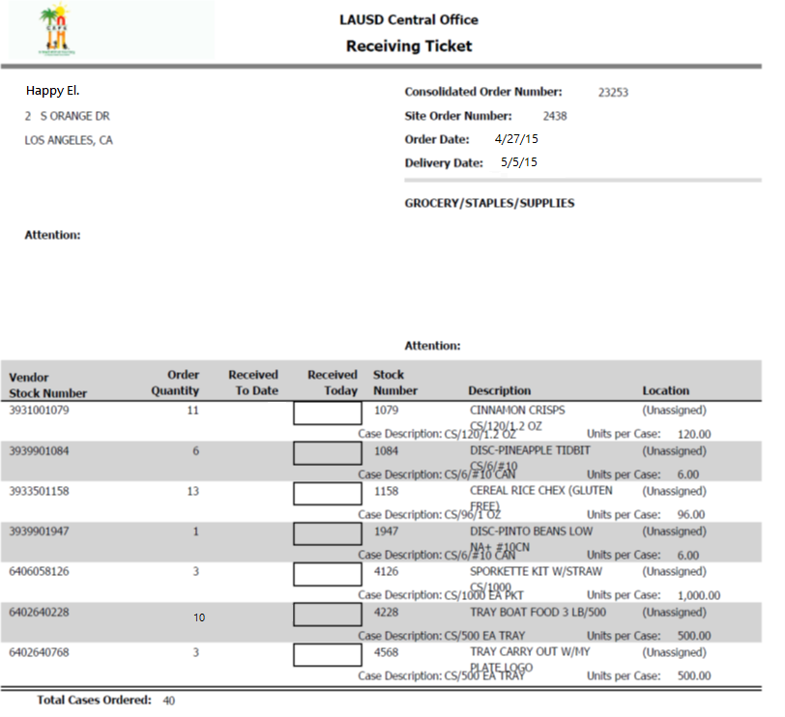
Reviewing Receiving Tickets
Reviewing receiving tickets allows FSM’s to verify that orders placed on the shopping list were consolidated by CMS.
In the event that receiving tickets are missing, the FSM should:
Place a remedy ticket
Contact vendors to verify order
Acquire necessary items
Notes:
TELL: Once the shopping list orders are consolidated, or collected, the FSM should review the receiving tickets according to the CMS calendar to verify that orders placed on the shopping list were consolidated by CMS. In the event that receiving tickets are missing, the FSM should place a remedy ticket to report the issue and contact vendors to verify the order receipt and acquire any items they need for the following week.
Next Slide

Slide 21
Effect of Receiving on Inventory
The accurate receipt of goods into CMS ensures that food cost and inventory levels are accurate for future orders. Additionally, proper receipt of food items provides FSM’s with the opportunity to account for any changes made by the vendor and records the changes.
FSM’s should make changes to the receipt of goods when there are:
Changes in pack size
Multiple invoices
Missing items
Additional items
Notes:
Tell: Once the inventory items are delivered to your school site, the accurate receipt of goods into CMS ensures that food cost and inventory levels are accurate for future orders. Additionally, proper receipt of food items provides FSM’s with the opportunity to correct any changes made by the vendor. FSM’s should make changes to the receipt of goods whenever there are changes in pack size of delivery items, whenever multiple invoices are received, or if there are any missing or additional items.
Next Slide

Slide 22
Importance of Timely Receiving
Vendors cannot be paid until receiving is completed. FSM’s should help facilitate vendor payments by:
Receiving goods daily
Inputting the correct invoice date
Ensuring the delivery date entered matches the delivery date on the invoice
Input appropriate invoice number
Any irregularities in deliveries should be annotated in the comments section and reported to the vendor.
Notes:
Tell: Vendors cannot be paid until receiving is completed. FSM’s should help facilitate vendor payments by receiving goods into CMS daily, ensuring that the correct invoice date, delivery date, and invoice number are all correct helps to ensure vendor payment accuracy and also reflects a more accurate cafeteria inventory costs. In the event that any irregularities occur in deliveries, such as the pack size changes in the previous slide, be sure to provide an annotation in the comments section and report it to the vendor.
Next Slide

Slide 23
Closing The Cycle
The inventory cycle requires FSM to constantly make changes to all of the factors that affect inventory. FSM’s should be proactive in:
Adjusting the shopping list to get the most accurate orders
Comparing the invoice with the receiving tickets to ensure accuracy
Notes:
Tell: Controlling your cafeteria’s inventory is a constant process. The inventory cycle requires FSM to constantly make changes to all of the factors that affect inventory. To ensure continued success in your cafeteria, remain proactive by adjusting the shopping list to get the most accurate orders, comparing the invoice with the receiving tickets to ensure accuracy, and to meet the par level.
Next Slide

Slide 24
Questions?
Thank you!
LAUSD Food Services Division
Nourishing Children to Achieve Excellence
Notes:
TELL: Thank you for attending the inventory training. If you have any questions or need assistance in improving your cafeteria operation, contact your Area Food Services Supervisor.
End of presentation

